Slide 1
IoT Summer School Day 3 TinyOS
James Brusey

Slide 2
Reflection on day 2

Slide 3
overview
Intro
Blink
Changing Blink
Debugging and sensing
Networking
Project development
Your demos!

Slide 4
Introduction

Slide 5
Introduction
We want you to learn the basics of TinyOS today
We want you to experience a bit of the excitement around IoT
We want to give you the starting point for learning more

Slide 6
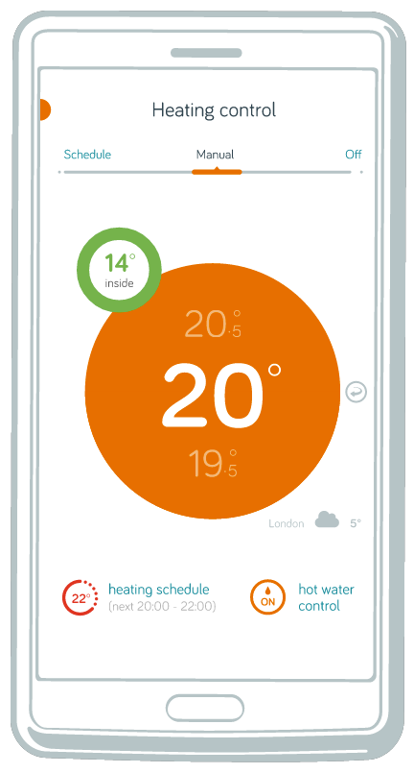
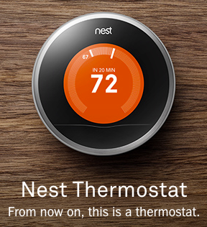
why is wireless / embedded / sensing important?
two examples
hive
and nest
and there are probably many more!

Slide 7
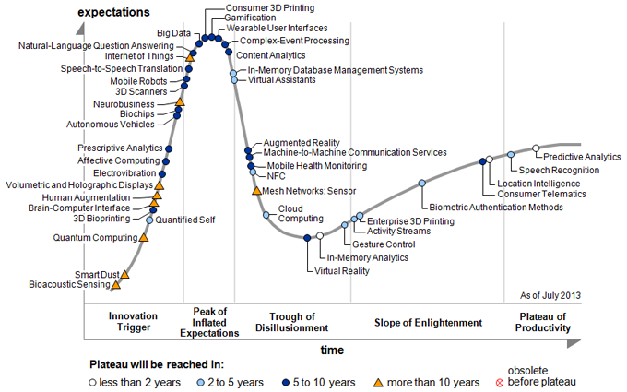
the hype cycle
source: www.gartner.com

Slide 8
why TinyOS?
TinyOS makes embedded, networked programming a little bit easier
most C code developers will feel at home (sort of)
it provides a library of tools and reusable components
it helps with concurrency

Slide 9
some troublesome concepts
concurrency - how to deal with many things going on at once
communication failure - how to design robust algorithms that allow for this
limited resources - how to limit CPU and memory requirements

Slide 10
Blink!

Slide 11
getting started
familiarise yourself with the command line
try out Blink
find a nice editor (I’m using emacs but you might like gedit)
modify Blink!

Slide 12
how to start with existing code
Make a copy of the directory containing the app (e.g. /opt/tinyos.../apps/Blink) into your home directory
Open a terminal window and go to that directory
Check that it compiles with “make telosb”
See next slides for step by step ...

Slide 13
Copy Blink from the command line
james@argon:~/Documents$ cp -r /opt/tinyos-main/apps/Blink .
james@argon:~/Documents$ cd Blink
james@argon:~/Documents/Blink$ ls
BlinkAppC.nc BlinkC.nc Makefile README.txt
james@argon:~/Documents/Blink$
Notes:
“cp” always takes at least two parameters (source and target)
“-r” is an option that tells cp to copy recursively (contents of the directory as well)
remember to use the TAB key to auto-complete as it speeds things up (and reduces errors)

Slide 14
flashing to the telos
Physically connect the telosb to your usb port
WARNING: be careful not to damage it! Sit something under your computer if you need to. Better still, use a usb hub or extender cable.
Tell VirtualBox to manage the device
Handy hint: put it in the settings and it will connect automatically every time without being told.
Check that it is there
motelist
Recompile and flash with
make telosb install
Avoid recompilation (just flash) with
make telosb reinstall

Slide 15
make a small change Blink
simple change: speed up the blinking!
harder problem: there are limited Timers, so let’s try implementing the same functionality with a single timer (instead of 3).
blink a different pattern - e.g. grey code

Slide 16
jump into the tutorial
http://tinyos.stanford.edu/tinyos-wiki/index.php/Main_Page

Slide 17
Intro to nesC

Slide 18
components and wiring
components provide services and use other services (e.g. BlinkC, LedsC)
when one component is wired to another, this means the compiler “connects” command calls from the user to the corresponding function in the provider
similarly it “connects” signal calls in the provider to event functions in the user
thus wiring is bidirectional (two way)

Slide 19
configurations and modules
A configuration starts with the word “configuration”
It wires modules together (under “implementation”)
It might provide or use interfaces (and thus need further wiring)
It doesn’t contain any ordinary C code
A module starts with the word “module”
It provides and uses interfaces and must be wired
It contains C-like code (under “implementation”)

Slide 20
interfaces
an interface starts with the word “interface”
it provides a template for command and event functions
unlike a configuration or a module, it doesn’t have an implementation section (this will be provided by a module)
modules state that they conform to an interface by saying that they “provide” it

Slide 21
split-phase interfaces
split phase interfaces allow for tasks that take some time. e.g. see the Read interface
split phase interfaces avoid threads
why?

Slide 22
commands and events
commands are like ordinary function calls (except for the wiring)
to execute, call the command
events are like callback functions
to execute, signal the event

Slide 23
tasks
a task is a deferred function call
a task begins with the word task and has no parameters or return value
tasks are “called” using the word post
never signal from a command - post a task to signal instead (why?)

Slide 24
exercise
http://tinyos.stanford.edu/tinyos-wiki/index.php/Modules_and_the_TinyOS_Execution_Model#TinyOS_Execution_Model:_Tasks

Slide 25
Debugging tools

Slide 26
four tools for debugging
Turning on or off (or toggling) an LED
Using “printf” support
Unit testing
Simulation

Slide 27
using the LEDs
Useful for answering questions like:
Does some event or error state occur (ever)?
Is an event occurring regularly (but not too fast)?
Not so good for:
Is a sensor reading meaningful and changing with the environment?
How many times is an event occurring (exactly)?
Exactly which error state occurred?

Slide 28
using printf
Good for:
checking sensor readings are reasonable
printing counts or numerical values
Not good for:
testing complex radio communication (why?)
testing a base station node connected serially

Slide 29
What you need in the makefile
COMPONENT=TestPrintfAppC
CFLAGS += -I$(TOSDIR)/lib/printf
#CFLAGS += -DNEW_PRINTF_SEMANTICS
include $(MAKERULES)

Slide 30
What you need in the configuration
configuration TestPrintfAppC{
}
implementation {
components MainC, TestPrintfC;
components new TimerMilliC();
components PrintfC;
components SerialStartC;
TestPrintfC.Boot -> MainC;
TestPrintfC.Timer -> TimerMilliC;
}

Slide 31
How to use in the module
#include "printf.h"
module TestPrintfC {
…
event void Timer.fired() {
printf("Hi I am writing to you from my TinyOS application!!\n");
printf("Here is a uint8: %u\n", dummyVar1);
printf("Here is a uint16: %u\n", dummyVar2);
printf("Here is a uint32: %ld\n", dummyVar3);
printfflush();
}

Slide 32
how to use printf
mote must be connected via USB port and visible on “motelist”
check /opt/tinyos-main/apps/tutorials/Printf
note the need for printfflush()
run java program as per tutorial
remember to stop java program before reprogramming
http://tinyos.stanford.edu/tinyos-wiki/index.php/The_TinyOS_printf_Library

Slide 33
exercise
Add some printf statements to RadioCountToLedsC to print out when a packet is received and with what value.

Slide 34
unit testing
unit tests provide a way of testing an individual component or function without having to run the full application
for TinyOS, we use a modified version of minunit.h
minunit is a freely available, minimal unit-testing framework
in our research lab, unit tests are no longer optional
all functions / components should have corresponding unit tests.

Slide 35
minunit.h
/* file: minunit.h */
/*************************************************************
Modification history:
1. 26/4/2013 J. Brusey add __FILE__ and __LINE__ so that it easier to
see where an assert is coming from.
*************************************************************/
#ifndef _MINUNIT_H
#define _MINUNIT_H
#define mu_strify1(s) #s
#define mu_strify(s) mu_strify1(s)
#define mu_assert(message, test) do { if (!(test)) return __FILE__ ":" mu_strify(__LINE__) ": assertion failed: " message; } while (0)
#define mu_run_test(test) do { char *message = test(); tests_run++; if (message) return message; } while (0)
extern int tests_run;
#endif
Don’t worry if you don’t understand this code. You can still use it!

Slide 36
in test code
static char* my_first_test(void) {
/* do some sort of test
...
*/
mu_assert("problem msg",
bool_condition)
return 0;
}
static char* all_tests(void) {
mu_run_test(my_first_test);
mu_run_test( ... );
...
return 0;
}
event void Boot.booted()
{
char *result = all_tests();
call Leds.led2Off();
call Leds.led1Off();
if (result != 0) {
printf("%s\n", result);
call Leds.led0On(); /* fail */
}
else {
printf("ALL TESTS PASSED\n");
call Leds.led1On(); /* pass */
}
printf("Tests run: %d\n", tests_run);
printfflush();
}

Slide 37
in test code
static char* my_first_test(void) {
/* do some sort of test
...
*/
mu_assert("problem msg",
bool_condition)
return 0;
}
static char* all_tests(void) {
mu_run_test(my_first_test);
mu_run_test( ... );
...
return 0;
}
add in test case method calls here to create a suite of test cases
event void Boot.booted()
{
char *result = all_tests();
call Leds.led2Off();
call Leds.led1Off();
if (result != 0) {
printf("%s\n", result);
call Leds.led0On(); /* fail */
}
else {
printf("ALL TESTS PASSED\n");
call Leds.led1On(); /* pass */
}
printf("Tests run: %d\n", tests_run);
printfflush();
}

Slide 38
in test code
static char* my_first_test(void) {
/* do some sort of test
...
*/
mu_assert("problem msg",
bool_condition)
return 0;
}
static char* all_tests(void) {
mu_run_test(my_first_test);
mu_run_test( ... );
...
return 0;
}
event void Boot.booted()
{
char *result = all_tests();
call Leds.led2Off();
call Leds.led1Off();
if (result != 0) {
printf("%s\n", result);
call Leds.led0On(); /* fail */
}
else {
printf("ALL TESTS PASSED\n");
call Leds.led1On(); /* pass */
}
printf("Tests run: %d\n", tests_run);
printfflush();
}
this code should actually test your code (e.g. run a method, etc)

Slide 39
in test code
static char* my_first_test(void) {
/* do some sort of test
...
*/
mu_assert("assert msg",
bool_condition)
return 0;
}
static char* all_tests(void) {
mu_run_test(my_first_test);
mu_run_test( ... );
...
return 0;
}
event void Boot.booted()
{
char *result = all_tests();
call Leds.led2Off();
call Leds.led1Off();
if (result != 0) {
printf("%s\n", result);
call Leds.led0On(); /* fail */
}
else {
printf("ALL TESTS PASSED\n");
call Leds.led1On(); /* pass */
}
printf("Tests run: %d\n", tests_run);
printfflush();
}
then use “mu_assert”, which will check the boolean condition and if false, will issue the “assert message” along with the line number

Slide 40
exercise
Examine some more complex code that makes use of unit testing and try to understand each test
https://code.google.com/p/cogent-house/source/browse/tos/Node/Filters/DEWMA/DEWMATestP.nc
https://code.google.com/p/cogent-house/source/browse/tos/Node/PackState/PackStateTestP.nc
Note: TinyOS source also has a separate unit test framework but this only works with TOSSIM.

Slide 41
simulation with TOSSIM
Simulation is appropriate for
larger scale tests (with more motes than available)
network communication testing
Simulation might not help with:
identifying simple problems (printf / leds may be quicker)
sensor related issues

Slide 42
simulation with TOSSIM
Key concepts:
Always specify platform as micaz
Python is used to interact with simulator
dbg() statements in code to print during simulation (but we need to direct the output)
The amount of time between events varies
http://tinyos.stanford.edu/tinyos-wiki/index.php/TOSSIM

Slide 43
Sensing

Slide 44
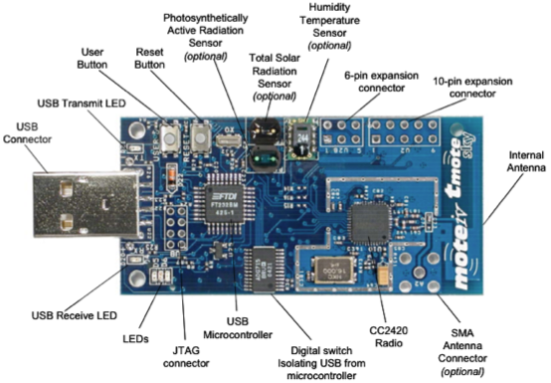
Telos Mote Hardware (front)

Slide 45
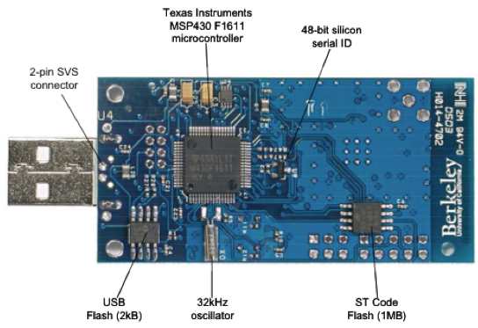
Telos Mote Hardware (back)

Slide 46
Obtaining sensor data in TinyOS
Sensor components provide a “read” interface:
interface Read<val_t> { command error_t read(); event void readDone(error_t result, val_t val); }
Some sensors also provide additional interfaces for bulk acquisition (ReadStream) or low-latency input (ReadNow)
(see TEP 101 and TEP 114 for more information)

Slide 47
exercise
Examine code that makes use of sensor input
identify the read call
identify the readDone event
identify which components are wired in for this to work

Slide 48
setting up the MSP430 ADC
See code in https://github.com/jbrusey/cogent-house/tree/pulp/tos/Node/Sensing/Analog
Also see base sensors here: https://github.com/jbrusey/cogent-house/tree/pulp/tos/Node/Sensing/Base

Slide 49
Using AdcConfigure
To configure the ADC, you must provide the AdcConfigure interface and implement the getConfigure command
This command should return a data structure (which can be a constant struct) of type msp430adc12_channel_config_t
Structure details on next page - but for detailed guidance refer to the MSP430 F1611 data sheet

Slide 50
msp430adc12_channel_config_t
inch: input channel (0-7)
sref: which reference voltage to use for + / -
ref2_5v: reference voltage level (1.5, 2.5 or none)
adc12ssel: clock source sample hold time
adc12div: clock divider sample hold time
sht: sample hold time
sampcon_ssel: clock source sampcon signal
sampcon_id: clock divider sampcon

Slide 51
key things to remember
look at the data sheet
use sample code from Internet warily!
be aware of conflicting use of pins
check conversion
what is the true maximum adc value?
max / min voltage?
deal with noise in hardware first (but software later)
twist lead wires together
reduce lead wire distance if possible
filtering capacitor needed? placed where?

Slide 52
Networking

Slide 53
AMSend
interface AMSend {
command error_t send(am_addr_t addr, message_t * msg, uint8_t len);
event void sendDone(message_t * msg, error_t error);
command error_t cancel(message_t * msg); command uint8_t maxPayloadLength(); command void* getPayload(message_t * msg, uint8_t len);
}

Slide 54
AMSend
interface AMSend {
command error_t send(am_addr_t addr, message_t * msg, uint8_t len);
event void sendDone(message_t * msg, error_t error);
command error_t cancel(message_t * msg); command uint8_t maxPayloadLength(); command void* getPayload(message_t * msg, uint8_t len);
}
sending takes time, so the operation is split-phase

Slide 55
AMSend
interface AMSend {
command error_t send(am_addr_t addr, message_t * msg, uint8_t len);
event void sendDone(message_t * msg, error_t error);
command error_t cancel(message_t * msg); command uint8_t maxPayloadLength(); command void* getPayload(message_t * msg, uint8_t len);
}
addr can be a specific node id, or TOS_BCAST_ADDR to send to everyone
Current node id is in TOS_NODE_ID

Slide 56
AMSend
interface AMSend {
command error_t send(am_addr_t addr, message_t * msg, uint8_t len);
event void sendDone(message_t * msg, error_t error);
command error_t cancel(message_t * msg); command uint8_t maxPayloadLength(); command void* getPayload(message_t * msg, uint8_t len);
}
error_t can be:
SUCCESS
FAIL
EBUSY (subsystem is busy, try later)
ERETRY (something weird happened, try later)

Slide 57
AMSend
NEVER ignore the error_t return value. At the very least set a LED if the return is not SUCCESS
interface AMSend {
command error_t send(am_addr_t addr, message_t * msg, uint8_t len);
event void sendDone(message_t * msg, error_t error);
command error_t cancel(message_t * msg); command uint8_t maxPayloadLength(); command void* getPayload(message_t * msg, uint8_t len);
}
error_t can be:
SUCCESS
FAIL
EBUSY (subsystem is busy, try later)
ERETRY (something weird happened, try later)

Slide 58
exercise
Find an example bit of code that uses AMSend and check that you understand it.

Slide 59
Packets
A packet consists of
header (e.g. packet type)
payload (this is where your data goes)
footer
metadata
Note that message_t contains all the above and the sizes vary depending on platform. Thus, the only way to get a pointer to the payload is to ask for it with getPayload()

Slide 60
Packets
Packet payload is limited (default 28 bytes but can be increased to 114) - set TOSH_DATA_LENGTH in Makefile to increase

Slide 61
Acknowledgement
By default, no ack’s are sent
Even more advanced protocols (CTP) do not necessarily provide end-to-end acknowledgement
PacketAcknowledgements interface provides for acks
You can also manually implement your own ARQ (Automatic ReQuest response) scheme

Slide 62
Message buffers
TinyOS does not allow dynamic memory allocation
Therefore, message buffers are pre-allocated
How do we handle a protocol stack?
App layer
message_t* Receive(message_t *msg)
Routing layer
message_t* Receive(message_t *msg)
Link reliability layer
message_t* Receive(message_t *msg)

Slide 63
Message buffers
The return message_t from Receive is a “fresh” area to receive the next packet into.
It should only be the same packet if:
the received packet can be ignored and discarded, or
the data has been completely processed

Slide 64
Example receive
Example receive pseudo code (for forwarding) looks like:
receive(m):
if m is not for me: return m
if I have no buffers left: return m
else
add a pointer to m on the forwarding queue
return next available free buffer area

Slide 65
Multi-hop?
AMSend does single hop (only)
To do multi-hop, we can:
develop our own routing algorithm (fun!)
use CTP or Dissemination
use BLIP or some other point-to-point routing algorithm

Slide 66
exercise
Have a think about how you would devise a simple routing protocol with fixed routes. What do you need to store at each node?

Slide 67
exercise
Try out the Network Protocols section of the tinyos tutorials

Slide 68
Project development

Slide 69
Project development
Identify a small challenge for yourself or your team
Start with something simple (e.g., print your name)
Expand based on the ideas in the slides
Add sensing - e.g., temperature, humidity, battery voltage
Add networking - e.g., flood transmit your temperature values
etcetera!

